Slide 1
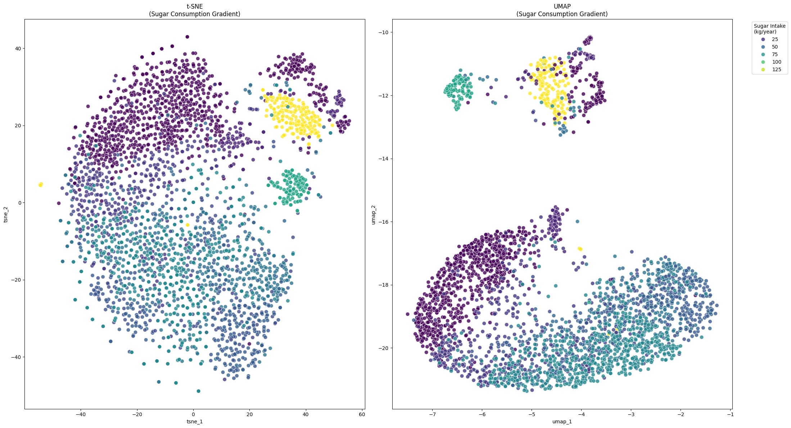
Sugar intake

Slide 2
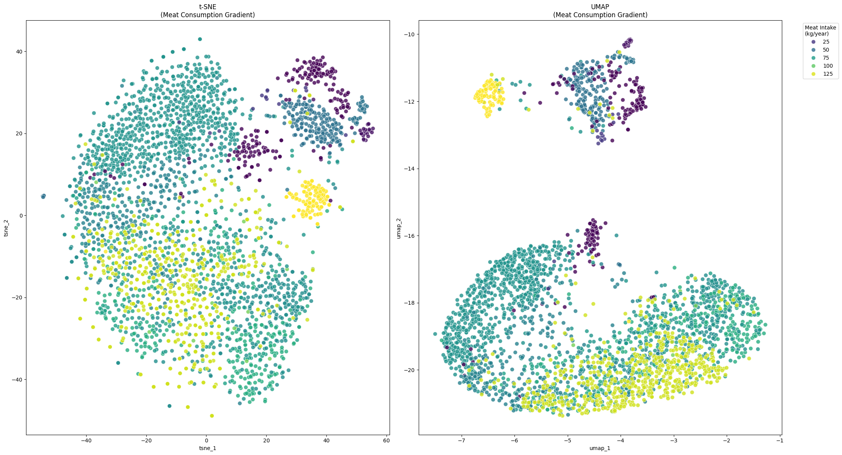
Meat consumption

Slide 3
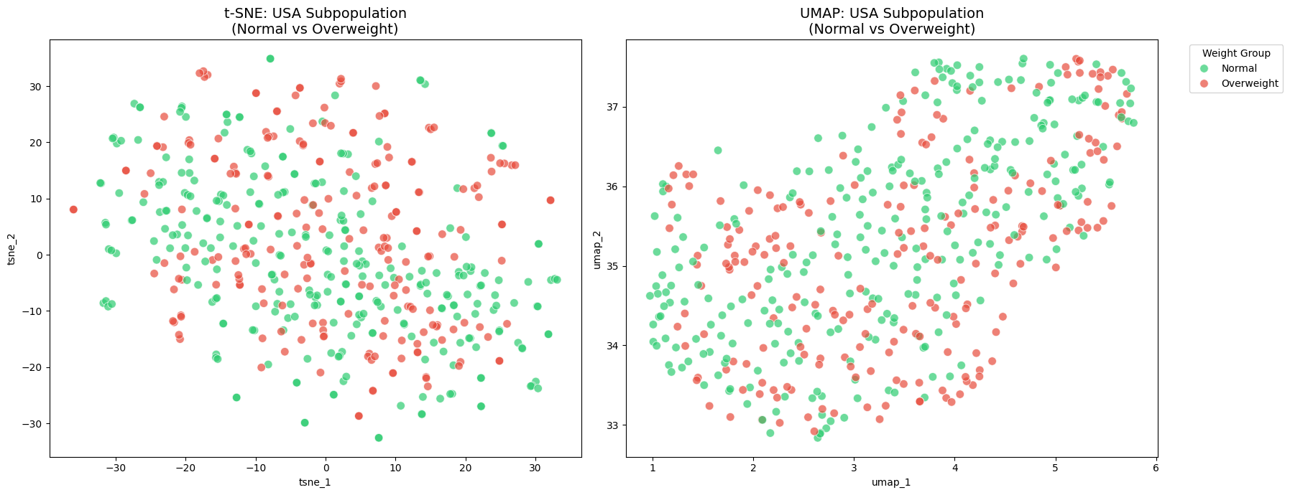
Obesity US

Slide 4
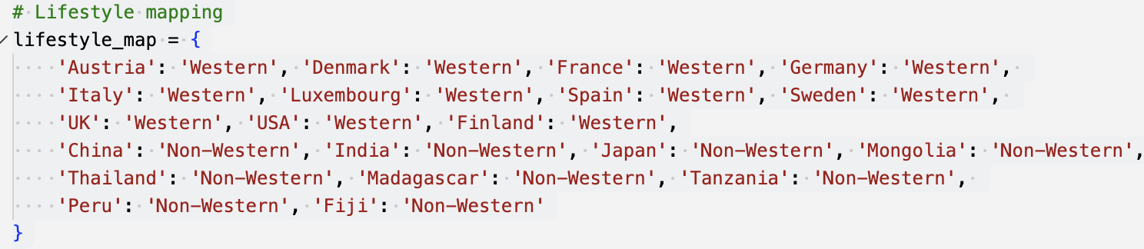
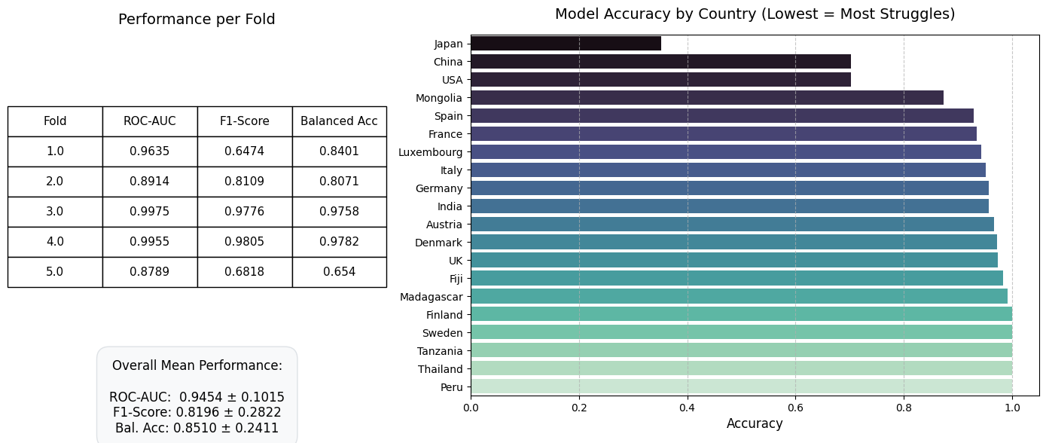
Western vs. Non-western

Slide 5
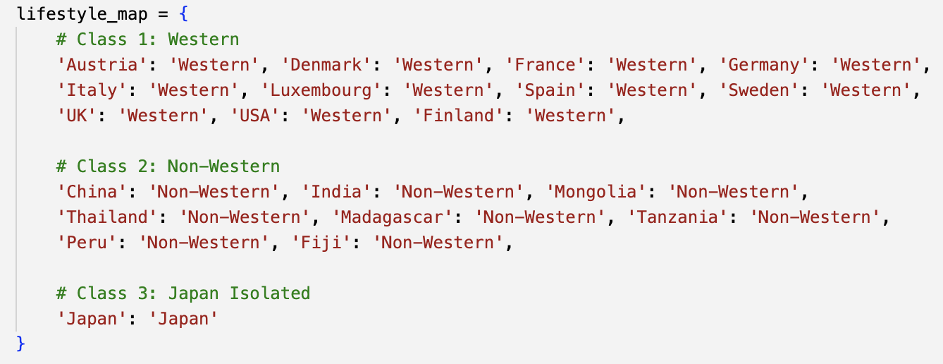
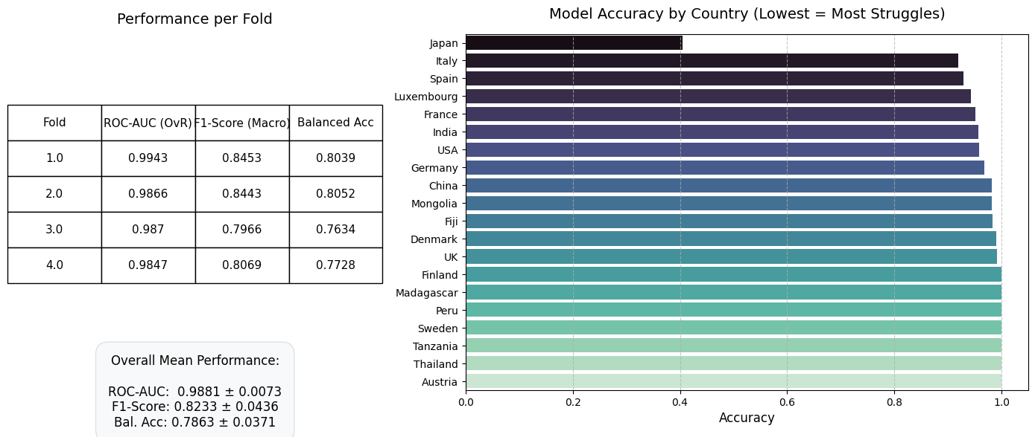
Western vs. Non-western vs. Japan
StratifiedKFold

Slide 6
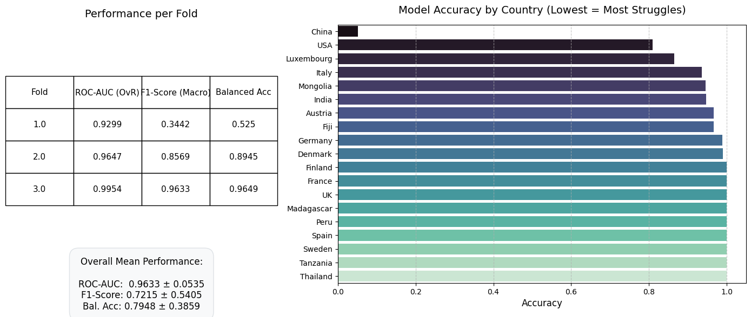
Western vs. Non-western
Without Japan

Slide 7
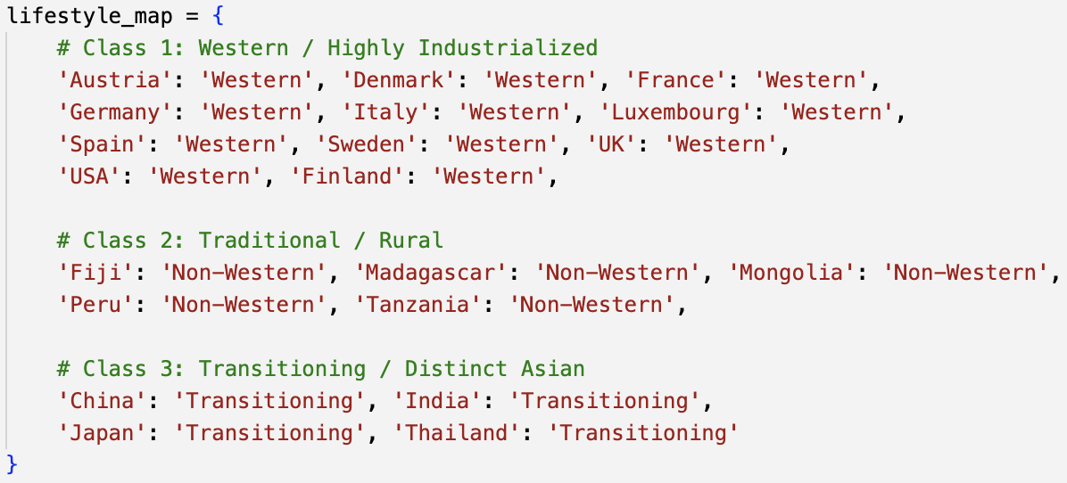
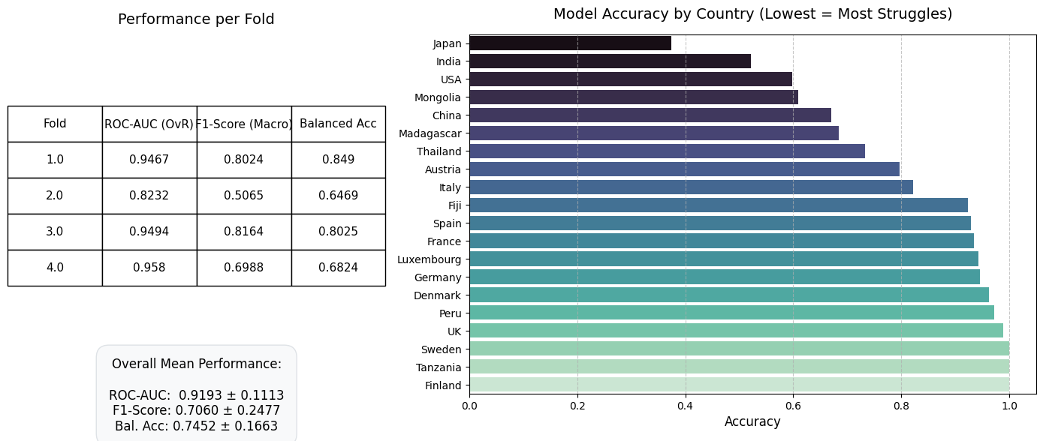
Western vs. Non-western vs. Transitioning

Slide 8
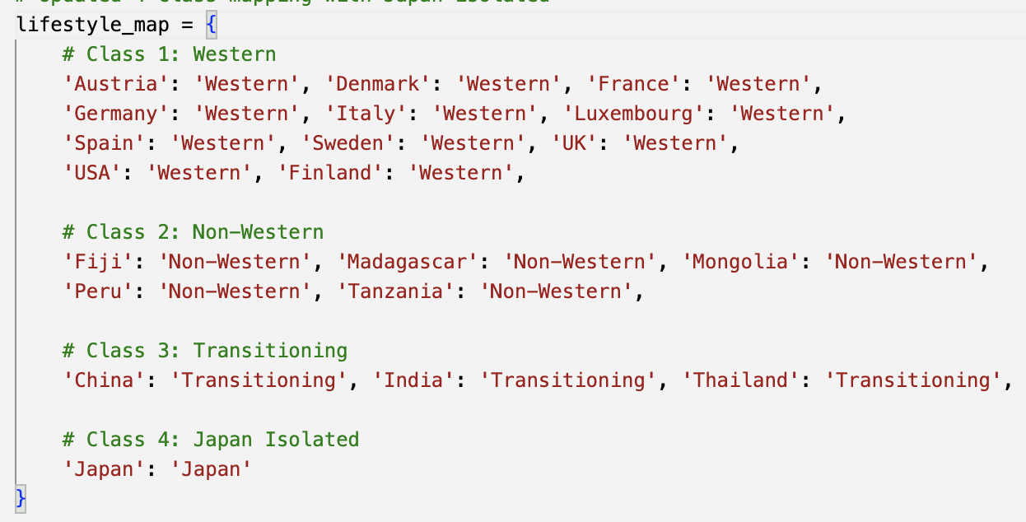
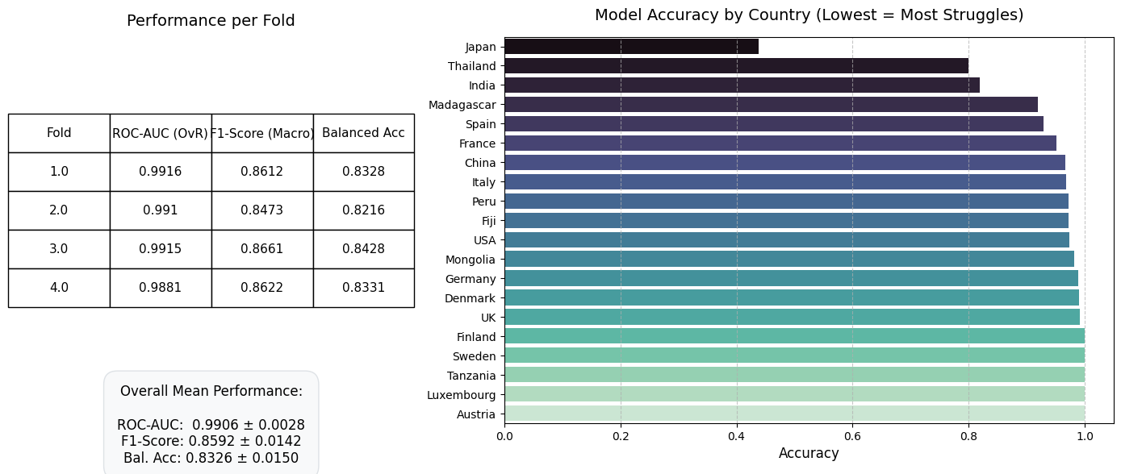
Western vs. Non-western vs. Transitioning vs. Japan
StratifiedKFold

Slide 9
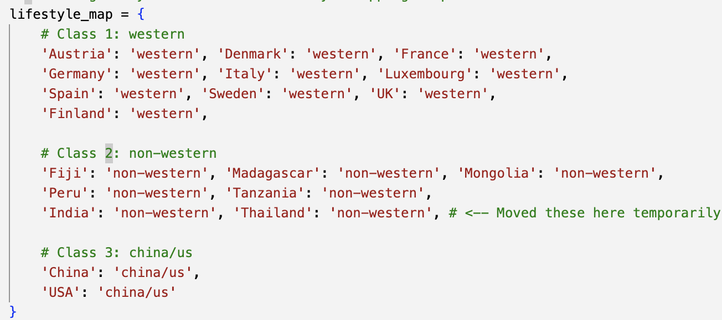
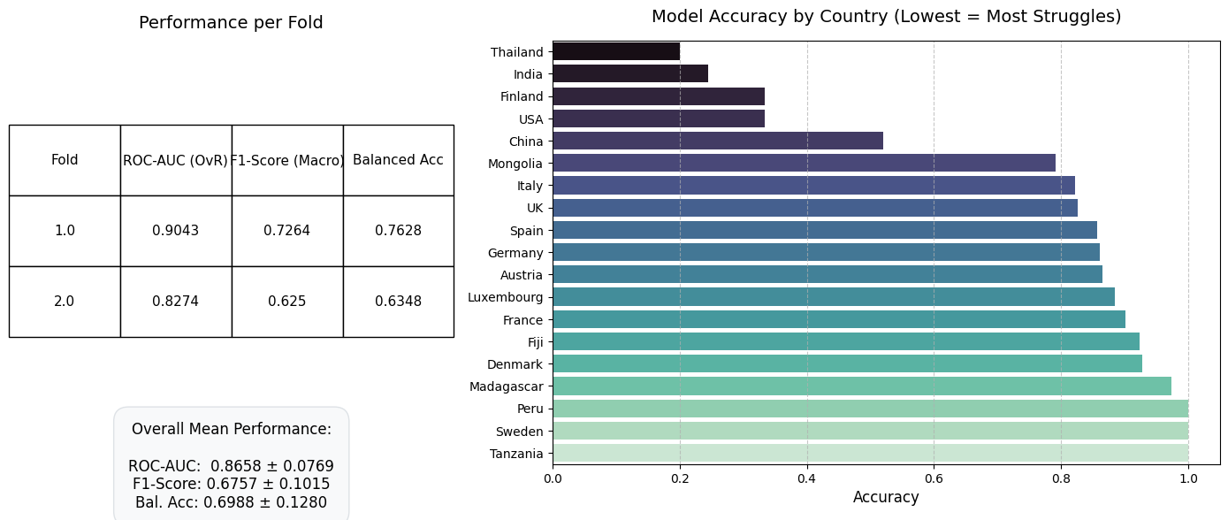
Western vs. Non-western vs. US/China
→ without Japan

Slide 10
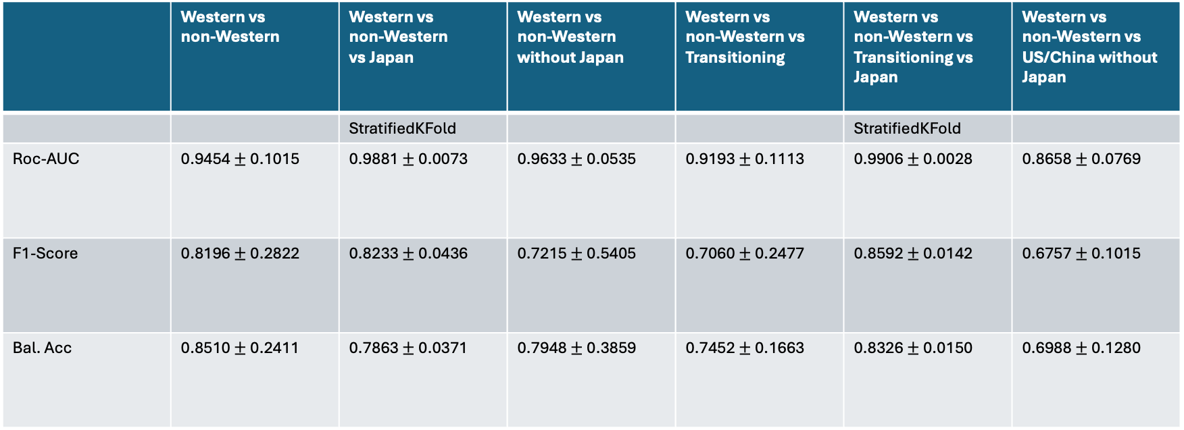
 | Western vs non-Western | Western vs non-Western vs Japan | Western vs non-Western without Japan | Western vs non-Western vs Transitioning | Western vs non-Western vs Transitioning vs Japan | Western vs non-Western vs US/China without Japan
 |  | StratifiedKFold |  |  | StratifiedKFold
Roc-AUC | 0.9454 $±$ 0.1015 | 0.9881 $±$ 0.0073 | 0.9633 $±$ 0.0535 | 0.9193 $±$ 0.1113 | 0.9906 $±$ 0.0028 | 0.8658 $±$ 0.0769
F1-Score | 0.8196 $±$ 0.2822 | 0.8233 $±$ 0.0436 | 0.7215 $±$ 0.5405 | 0.7060 $±$ 0.2477 | 0.8592 $±$ 0.0142 | 0.6757 $±$ 0.1015
Bal. Acc | 0.8510 $±$ 0.2411 | 0.7863 $±$ 0.0371 | 0.7948 $±$ 0.3859 | 0.7452 $±$ 0.1663 | 0.8326 $±$ 0.0150 | 0.6988 $±$ 0.1280

